Slide 1




DATA 400 MINI Project: Pennsylvania Casino Analysis
Kieran Santos

Slide 2


Research Question:
"Does online gambling provide a more stable and predictable revenue stream compared to table games, slots, and sports betting?"
VS.

Slide 3
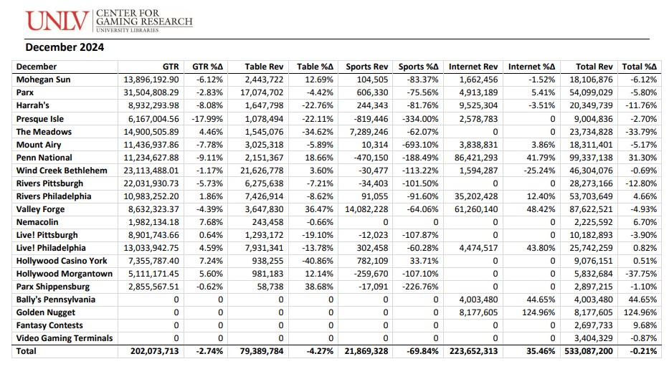
The Dataset: Slot, Table, Sports, Internet and Total Revenues by Month (2023-2024)
Columns:
GTR (Gross (slot machine) terminal revenue)
Table Rev: Table revenue;
Sports Rev: Sports Wagering revenue;
Internet Rev: Internet Gaming revenue;
Total Rev: Slot + table revenue;
%Δ: Year/year change for the month
Rows:
Various Casinos across PA
23 Rows x 11 Columns x 60
https://gaming.library.unlv.edu/reports/pa_monthly.pdf

Slide 4
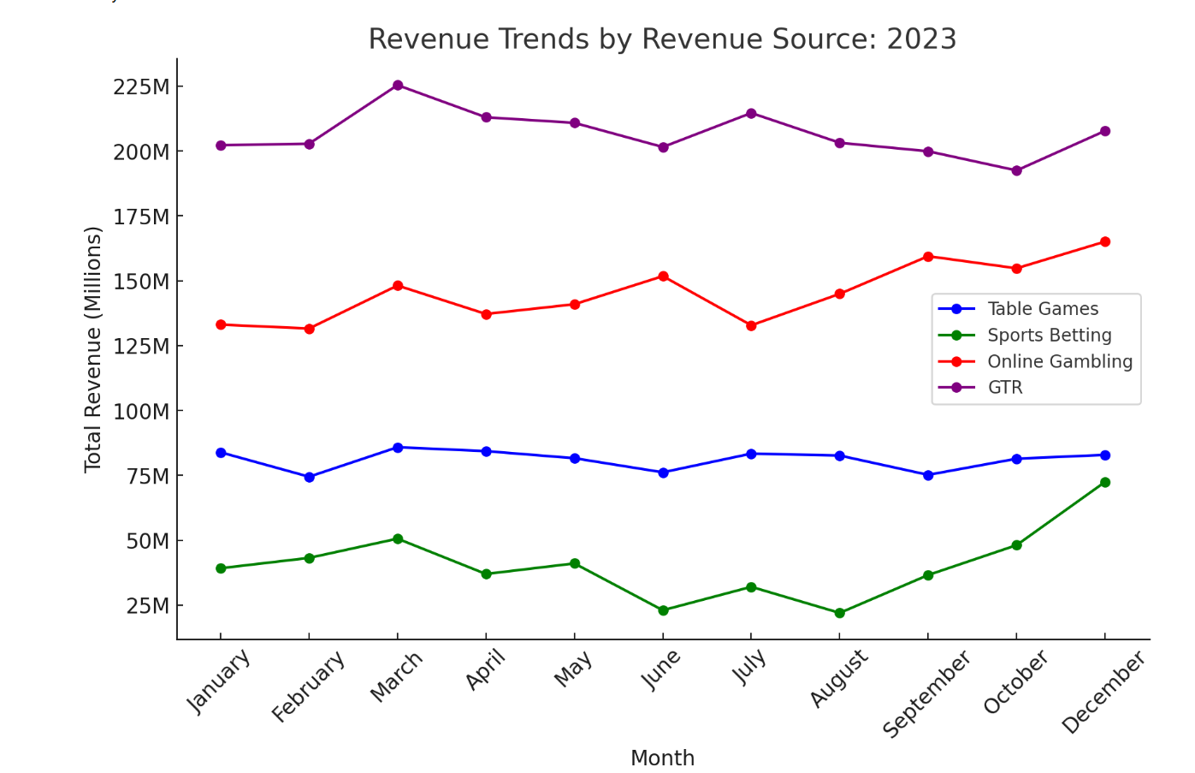
Exploratory Data Analysis:
Online gambling revenue shows steady growth, most positive trend
Sports betting is the most volatile source, table games and online gambling provide more consistent earnings.
GTR is consistently generates the most revenue for each casino

Slide 5
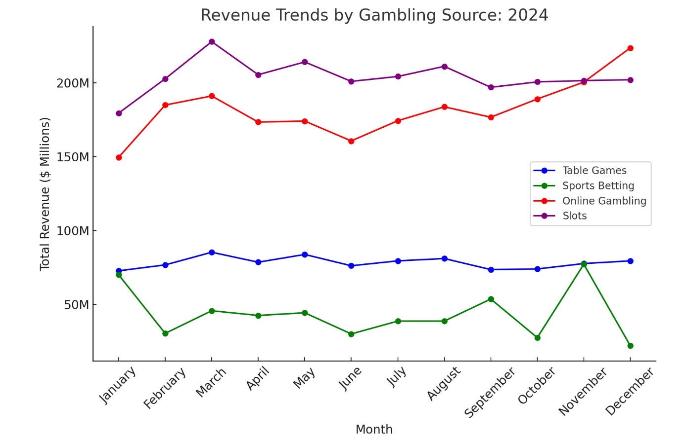
Exploratory Data Analysis:
Online gambling revenue continued to grow steadily in 2024
Sports betting remained the most volatile revenue source
Slots followed a relatively stable trend

Slide 6
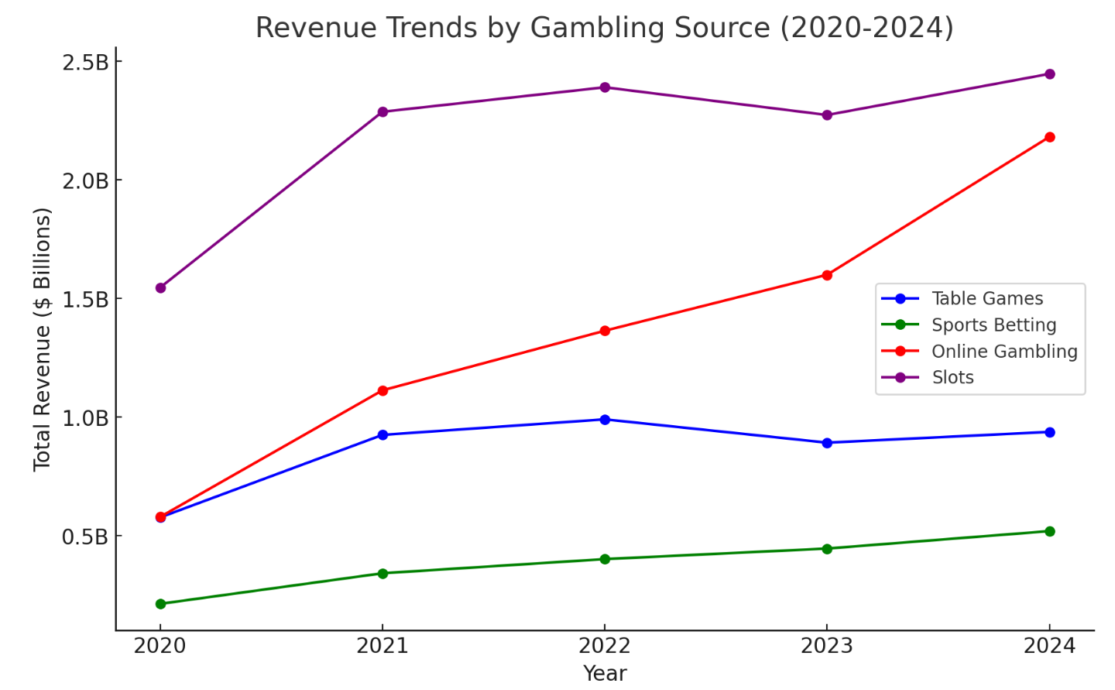
Exploratory Data Analysis:
Online Gambling has shown consistent growth from 2020 to 2024, becoming a more significant revenue source.
Sports Betting remains the most volatile.
Slots and Table Games have remained relatively stable, but slower growth compared to Online Gambling.

Slide 7

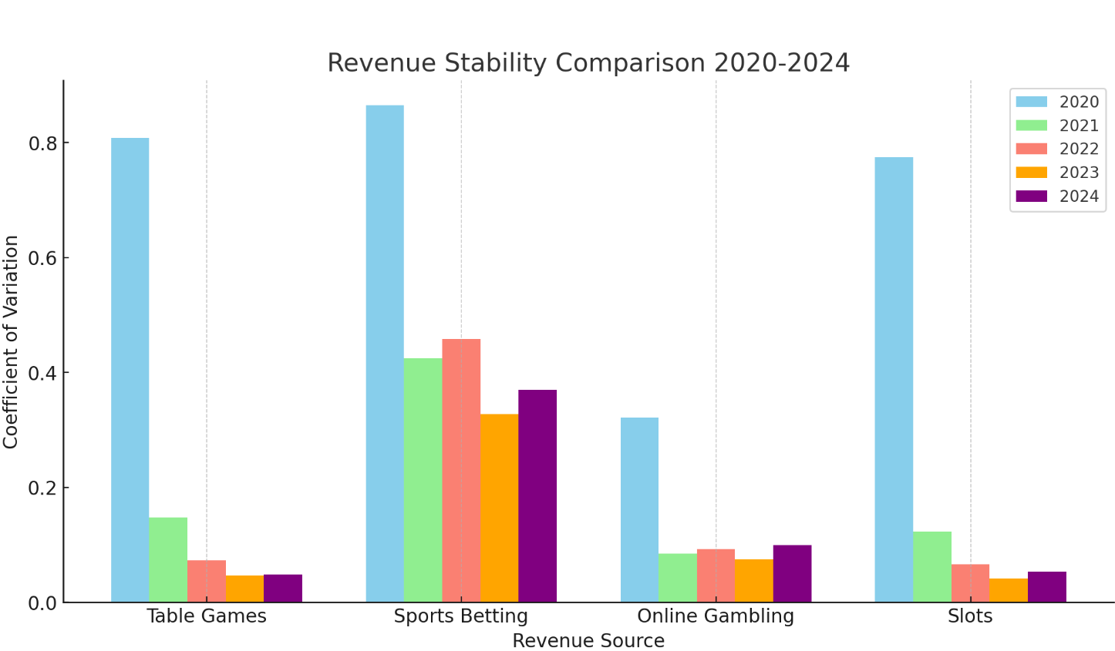
Exploratory Data Analysis:
Online Gambling consistently shows lower volatility than Sports Betting and Table Games, making it a more stable revenue source.
Sports Betting remains the most unpredictable revenue source, with the highest fluctuations across all years.
Slots have remained relatively stable over time, providing consistent revenue for casinos.

Slide 8
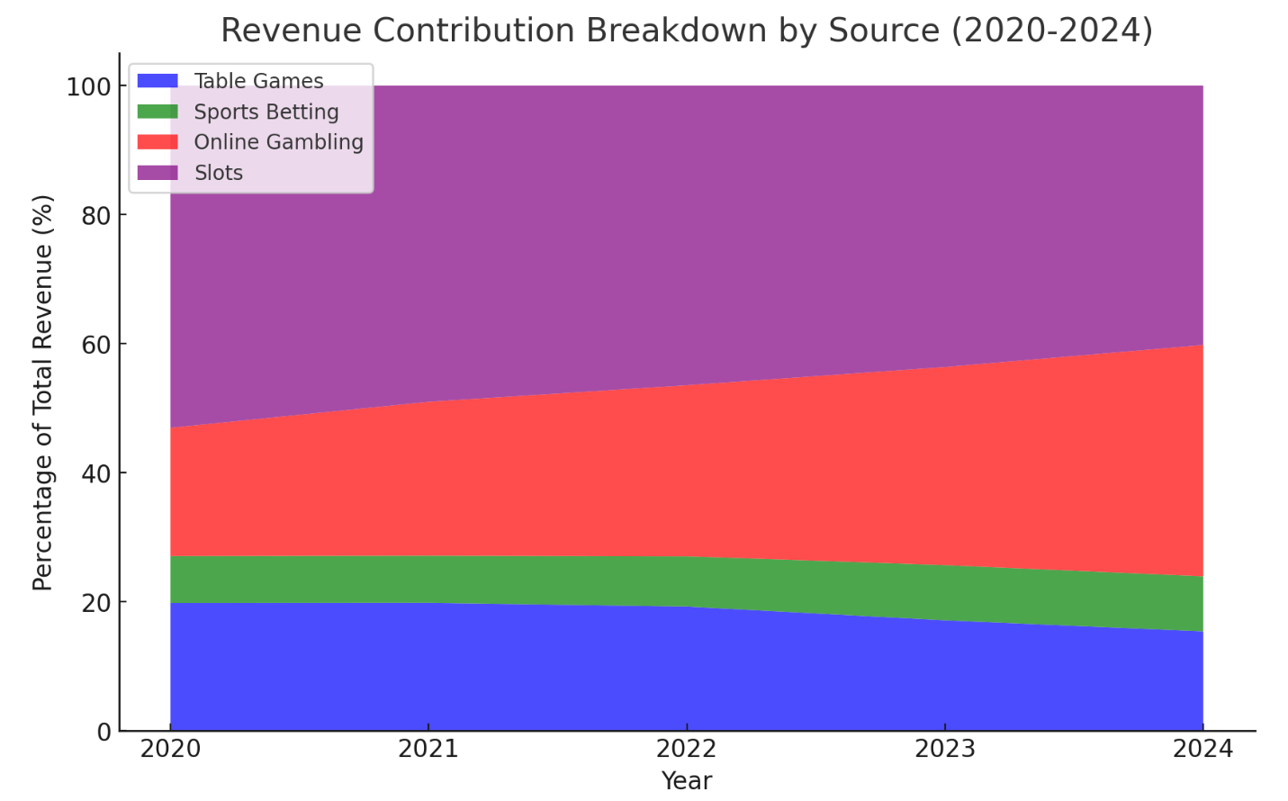
Exploratory Data Analysis:
Slots and Table Games have seen a gradual decline in their overall share.
Increasing share of Online Gambling suggests a long-term shift in consumer preferences

Slide 9




Implications for Stakeholders:
Casinos & Investors: Expanding into Online Gambling could be necessary for long-term profitability, as its stable growth suggests it will continue to capture a larger share of total revenue.
In-Person Casino Operators: Declining Table Games and Slots revenue share may require new strategies, such as integrating digital offerings, enhancing in-person experiences, (promos, vouchers, comps) or bundling in-person and online promotions to remain competitive.

Slide 10

Ethical, legal, societal implications:
Online gambling increases addiction risks and raises concerns about data privacy and targeted advertising.
Online gambling creates regulatory challenges in enforcement, taxation, and compliance since different states/countries have different regulations.
Increased digital accessibility may normalize gambling as a mainstream activity, leading to more young adults and casual users engaging in it.

